Slide 1
XML DOM Processing
Comp4711
#5a – Feb 3/09

Slide 2
XML DOM Processing
XML support in Java
The DOM
The DOM API
DOM pros/cons
Examples

Slide 3
1. XML support in Java
org.w3c.dom
  Core DOM interfaces – tree structure
org.w3c.sax
  Core SAX interfaces – parsing events
javax.xml
  Bind, crypto, datatype, namespace, parsers, soap, stream, transform, validation, ws, xpath
javax.xml (J2EE)‏
  Rpc

Slide 4
2. The DOM
(Document Object Model)‏
A platform- and language-neutral interface that will allow programs and scripts to dynamically access and update the content, structure and style of documents.
The XML Document Object Model (DOM) is an API for XML documents. It defines the way an XML document can be accessed and manipulated.
Notes:
Pseudo-code:
do {
get the next command
if it is not a quit or empty {
execute it
if (it was a query) {
display results
}
else {
report how many records were updated
}
}
} while (quit has not been issued)‏

Slide 5
Purpose of XML DOM
Map inherent tree structure of XML into memory
Defines standard set of objects for accessing and manipulating elements of an XML file
  Modify or delete elements
  Add elements at particular location
  Can even create an XML document

Slide 6
DOM Nodes
A document is a tree structured hierarchy of node objects
Many different types of nodes (elements, attributes, text)‏
Document root is itself a Node
How to get the text value of a node??

Slide 7
Picture of Example DOMNote.xml Document
note
time
to
from
heading
body

Slide 8
What do all objects have?
“Identity”
  Name of the node
  Some nodes don't really have name
State
  What does this node contain?
Behaviour
  Node methods

Slide 9
3. DOM API Concepts
All Nodes represent elements in the Document
  can walk through the tree using recursion
  figure out as you go
Strict (complicated) set of rules based on node:
  name
  value
  attributes

Slide 10
DOM Interface
Description
Document
XML document top-level node, which provides access to all the other nodes, including the root element
Node
Represents any node
NodeList
A read-only list of Node objects
Element
Derives from node & represents an element node
Attr
Derives from node & represents an attribute node
CharacterData
Derives from node & represents character data
Text
Derives from CharacterData & represents a text node
Comment
Derives from CharacterData & represents a comment node
ProcessingInstruction
Derives from node & represents a processing instruction
CDATASection
Derives from text & represents a CDATA section

Slide 11
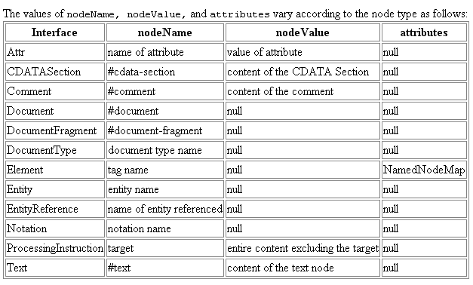
Node Types Names and Values

Slide 12
Document Interface
Document represents the top-level node of an XML document in memory and provides a means of creating nodes and retrieving nodes.
Note to self: refer to API docs + image

Slide 13
Node Interface
Node represents an XML document node.
Main component of XML document
All other interfaces are inherited from Node
  Element, Document, Comment, Notation, Attr
Term node is overloaded slightly
  Has specific and general meaning
Note to self: refer to API docs + image

Slide 14

4. Strengths
Tree structure easy to use
Entire content of document available in memory
Can find any node easily
Knowledge transferable from one language to another
Java version treats all nodes the same
Maturing with many new features
  real time validation during updates
Feature list keeps growing with each new version
  offering many valuable features (e.g. real-time validation with DOM updating)‏
Implementation in C++, Perl, C …

Slide 15
Weaknesses
Memory hog for large documents (whole loaded)‏
Slow initially for large documents
Doesn't use all features of all languages
DOM has no “cursor”
Complex set of rules about getting value on a node
  And have to get back text node first!
No standard agreement on getting a DOM parser:
  Sun has JAXP
  Xerces has DOMParser
  Although the interfaces are defined, classes are not (nor is their exact implementation)‏
No standard way to serialize DOM trees

Slide 16
5. DOM Code A
// Parses an XML file and returns a DOM document.
// If validating is true, the contents is validated against the DTD
// specified in the file.
public static Document parseXmlFile(String filename, boolean validating) {
  try {
    // Create a builder factory
DocumentBuilderFactory factory = DocumentBuilderFactory.newInstance();
factory.setValidating(validating);
// Create the builder and parse the file
    Document doc = factory.newDocumentBuilder().parse(new File(filename));
return doc;
} catch (SAXException e) {
// A parsing error occurred; the xml input is not valid
} catch (ParserConfigurationException e) {
} catch (IOException e) {
}
return null;
}

Slide 17
Code B
Document doc = parseXmlFile("infilename.xml", true);
visit(doc, 0);
// This method visits all the nodes in a DOM tree
public static void visit(Node node, int level) {
  // Process node
// If there are any children, visit each one
NodeList list = node.getChildNodes();
for (int i=0; i<list.getLength(); i++) {
// Get child node
Node childNode = list.item(i);
// Visit child node
visit(childNode, level+1);
  }
}

Slide 18
Code C
Document doc = parseXmlFile("infilename.xml", false);
// Obtain an element
Element element = doc.getElementById("key1");
// Determine the presence of an attribute
boolean has = element.hasAttribute("value"); // true
// Get an attribute value; returns null if not present
String attrValue = element.getAttribute("value"); // value1
// Change the value of an attribute
element.setAttribute("value", "newValue1");
// If an attribute is not specified in the XML but has a
// default value, the attribute is automatically created
element = doc.getElementById("key2");
has = element.hasAttribute("value"); // true
attrValue = element.getAttribute("value"); // value2

Slide 19
Code D
This is the sample input for the example:
<?xml version="1.0" encoding="UTF-8"?>
<root>
Here is <b>some</b> text
</root>
This is the resulting XML:
<?xml version="1.0" encoding="UTF-8"?>
<root>
Here is some text
</root>

Slide 20
Code D2
Document doc = parseXmlFile("infilename.xml", false);
// Obtain the root element to remove
Element element = (Element)doc.getElementsByTagName("b").item(0);
// Get the parent of the element
Node parent = element.getParentNode();
// Move all children of the element in front of the element
while (element.hasChildNodes()) {
  parent.insertBefore(element.getFirstChild(), element);
}
// Remove the element
parent.removeChild(element);
// Merge all text nodes under the parent
parent.normalize();

